Slide 1
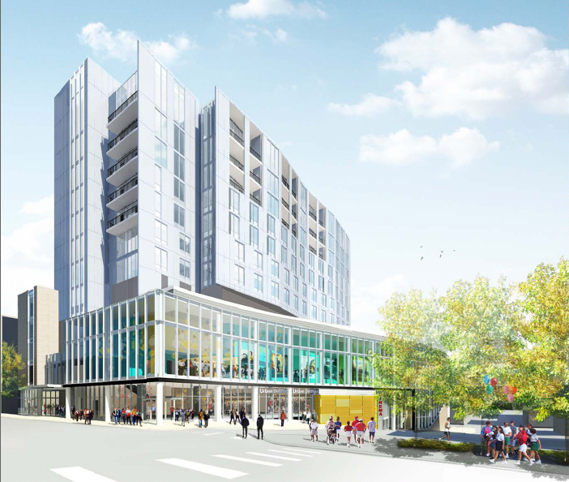
Tyler Strange
Structural Option
Consultant: Dr. Thomas Boothby
April 13, 2011
Fraser Centre
State College, PA
Tyler Strange
Structural Option
Fraser Centre
Dr. Thomas Boothby
April 13th, 2011

Slide 2
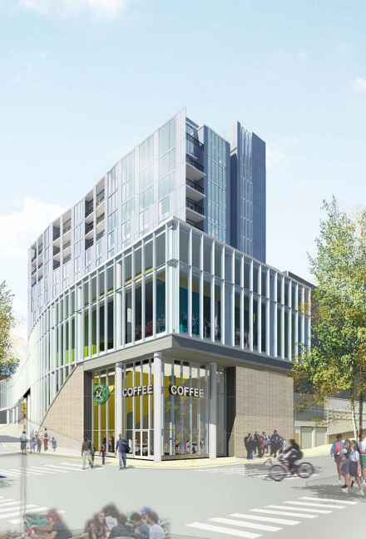
Presentation Outline
Introduction
Existing System
Proposal
Gravity System Redesign
  Composite Floor
  Steel Connections
Schedule and Cost Analysis
Lateral System Redesign
Architectural Analysis
Conclusion
Fraser Centre
State College, PA
Tyler Strange
Structural Option
Fraser Centre
Dr. Thomas Boothby
April 13th, 2011

Slide 3
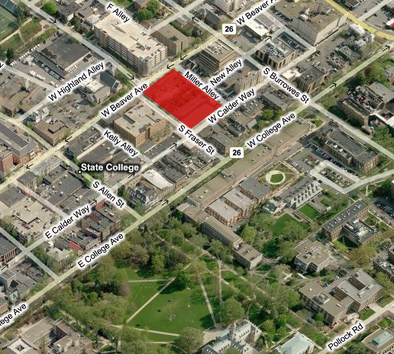
Introduction to Fraser Centre
Presentation Outline
General Information
Introduction
Existing System
Proposal
Gravity System Redesign
  Composite Floor
  Steel Connections
Schedule and Cost Analysis
Lateral System Redesign
Architectural Analysis
Conclusion
11 story mixed-use building
  First story is parking
  Second story is parking and retail
  Third story is a theatre
  Fourth story is MEP
  Fifth-tenth stories are residential
  Eleventh story is suites
Location……………………...State College, PA
Fraser Street and Beaver Ave
Size…………………………..230,000 sf
Project Cost…………………Unreleased
Project Team
- Architect…….……………..Wallace Roberts & Todd, LLC
- General Contractor………Leonard S. Fiore, Inc.
- Structural Engineer………David Chou & Associates, Inc.
Tyler Strange
Structural Option
Fraser Centre
Dr. Thomas Boothby
April 13th, 2011

Slide 4
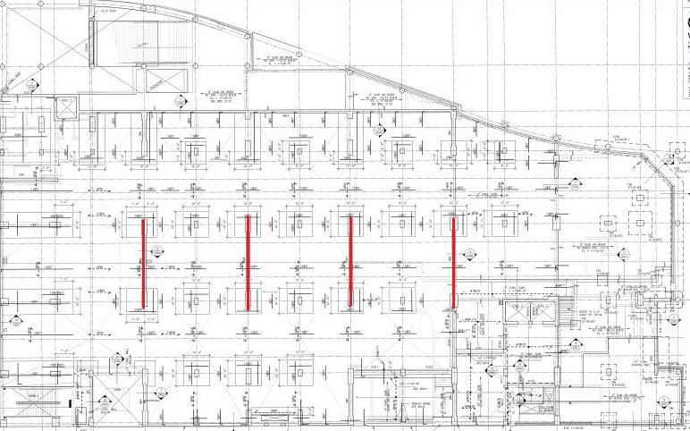
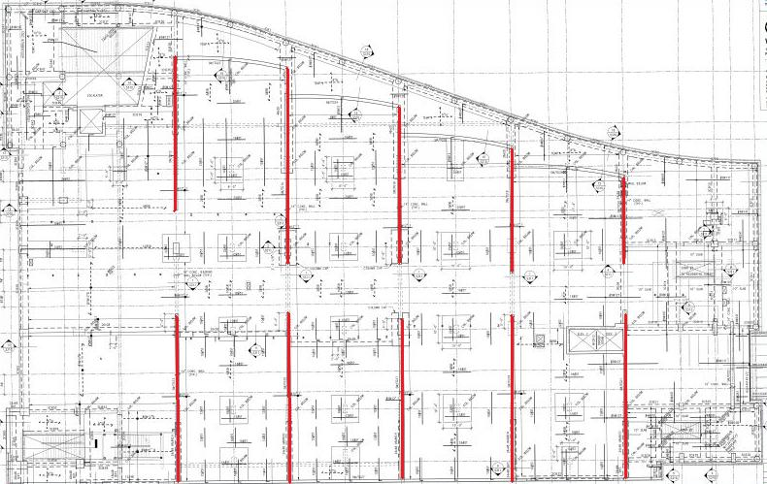
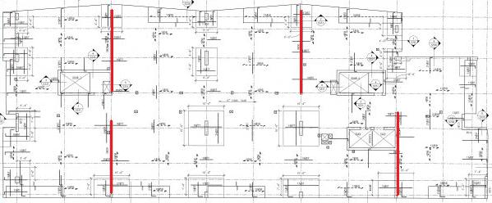
Existing System
Presentation Outline
Floor System
Introduction
Existing System
Proposal
Gravity System Redesign
  Composite Floor
  Steel Connections
Schedule and Cost Analysis
Lateral System Redesign
Architectural Analysis
Conclusion
Two-way 12 inch flat slab
Columns
Columns vary in size from 16in x 32in to 16in x 72in
Spans range from 28.5ft to 40ft
Shear Walls
4 shear walls located on the residential floors
Shear walls on the lower floors vary from 4 to 10
Tyler Strange
Structural Option
Fraser Centre
Dr. Thomas Boothby
April 13th, 2011

Slide 5
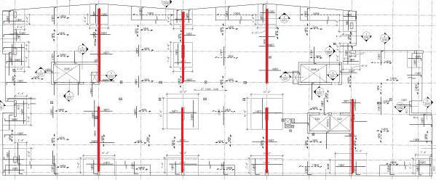
Proposal
Presentation Outline
Depth Proposal
Introduction
Existing System
Proposal
Gravity System Redesign
  Composite Floor
  Steel Connections
Schedule and Cost Analysis
Lateral System Redesign
Architectural Analysis
Conclusion
Change the floor system to composite concrete and steel beams for the residential levels
Redesign the residential shear walls with a new layout
Current Shear Wall Layout
Breadth Proposal
Analyze the change in cost and schedule of the new floor system
Analyze the impact the new shear wall layout will have on the architecture
Proposed Shear Wall Layout
Tyler Strange
Structural Option
Fraser Centre
Dr. Thomas Boothby
April 13th, 2011

Slide 6
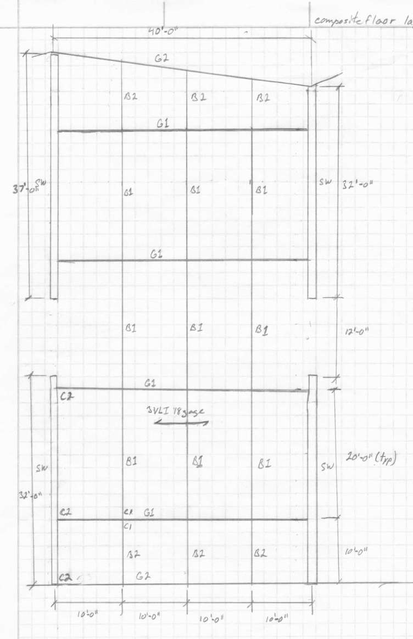
Composite Floor
Presentation Outline
Codes:
Introduction
Existing System
Proposal
Gravity System Redesign
  Composite Floor
  Steel Connections
Schedule and Cost Analysis
Lateral System Redesign
Architectural Analysis
Conclusion
Steel Deck: 3VLI Deck 18 Gage
B1: W12x16
B2: W10x12
G1: W18x76
G2: W16x31
C1: Welded/Bolted Single Angle L4x3x³/₈
C2: Bolted/Bolted Double Angle L4x3x³/₈
Original design code used ASCE 7-05
New design code used ASCE 7-10
Material Strengths:
Concrete: 4000 psi
Steel: 50000 psi
Load Combinations
1.2 Dead +1.6 Live
1.4 Dead
Tyler Strange
Structural Option
Fraser Centre
Dr. Thomas Boothby
April 13th, 2011

Slide 7
Composite Floor
Presentation Outline
Deflection Check:
Introduction
Existing System
Proposal
Gravity System Redesign
  Composite Floor
  Steel Connections
Schedule and Cost Analysis
Lateral System Redesign
Architectural Analysis
Conclusion
Steel Deck: 3VLI Deck 18 Gage
B1: W12x16
B2: W10x12
G1: W18x76
G2: W16x31
C1: Welded/Bolted Single Angle L4x3x³/₈
C2: Bolted/Bolted Double Angle L4x3x³/₈
Limited to L/360
Results:
3 in 18 gage VLI steel deck was used
4.5 in of concrete was used to achieve 2 hr fire rating
W Shapes range from W10x12 to W18x76
Thickness of residential floor system was increased by 12in
Tyler Strange
Structural Option
Fraser Centre
Dr. Thomas Boothby
April 13th, 2011

Slide 8
Steel Connections
Presentation Outline
Design:
Introduction
Existing System
Proposal
Gravity System Redesign
  Composite Floor
  Steel Connections
Schedule and Cost Analysis
Lateral System Redesign
Architectural Analysis
Conclusion
Steel Deck: 3VLI Deck 18 Gage
B1: W12x16
B2: W10x12
G1: W18x76
G2: W16x31
C1: Welded/Bolted Single Angle L4x3x³/₈
C2: Bolted/Bolted Double Angle L4x3x¹/₄
AISC Table 10-11
Girder to Beam is welded/bolted for constructability
Shear Wall to Girder is bolted/bolted for economics
Results:
Girder/Beam connection:
  Welded/Bolted Single Angle
  L4x3x3/8
  3/16th weld
  Two A325N ¾” dia. bolts
Shear Wall/Girder connection:
  Bolted/Bolted Double Angle
  L4x3x1/4
  Three A325N ¾” dia. bolts
Tyler Strange
Structural Option
Fraser Centre
Dr. Thomas Boothby
April 13th, 2011

Slide 9
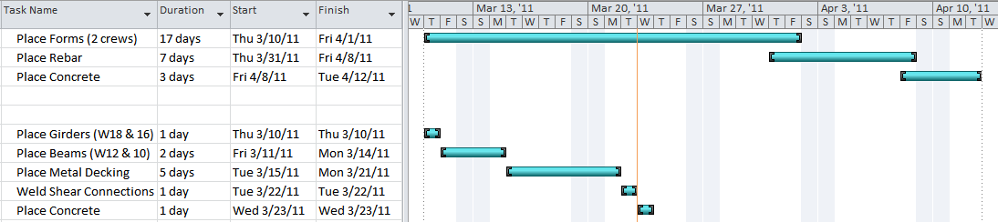
Schedule and Cost Analysis
Presentation Outline
Schedule Analysis
Introduction
Existing System
Proposal
Gravity System Redesign
  Composite Floor
  Steel Connections
Schedule and Cost Analysis
Lateral System Redesign
Architectural Analysis
Conclusion
Current system takes 24 days to complete a single floor with slight overlap.
Alternative system takes 10 days to complete a single floor with a linear progression.
Tyler Strange
Structural Option
Fraser Centre
Dr. Thomas Boothby
April 13th, 2011

Slide 10
Schedule and Cost Analysis
Presentation Outline
Cost Analysis
Description | Cost Estimate
Struct. Steel W16x31 | 260,361
Struct. Steel W18x76 | 829,142
Struct. Steel W10x12 | 74,389
Struct. Steel W12x16 | 333,575
Metal Decking | 5,450,667
Weld Shear Conn | 66,410
4 ksi Ready Mix | 20,235
Placing Concrete | 12,597
 | 7,047,374 | Total
Introduction
Existing System
Proposal
Gravity System Redesign
  Composite Floor
  Steel Connections
Schedule and Cost Analysis
Lateral System Redesign
Architectural Analysis
Conclusion
Description | Cost Estimate
In Place Forms | 2,212,344
In Place Reinforcing | 3,432
4 ksi Ready Mix | 60,492
Placing Concrete | 37,658
 | 2,313,926 | Total
Cost of Current System
Cost of Alternative System
Tyler Strange
Structural Option
Fraser Centre
Dr. Thomas Boothby
April 13th, 2011

Slide 11
Lateral System Redesign
Presentation Outline
Initial Shear Wall Layout
Introduction
Existing System
Proposal
Gravity System Redesign
  Composite Floor
  Steel Connections
Schedule and Cost Analysis
Lateral System Redesign
Architectural Analysis
Conclusion
Discontinuous between parking levels, theater level, and residential levels
Architectural restraints on position and size
Proposed Shear Wall Layout
Continuous from theater level to residential levels
Number of shear walls is increased from four to seven
Shear walls are reduced in size
Tyler Strange
Structural Option
Fraser Centre
Dr. Thomas Boothby
April 13th, 2011

Slide 12
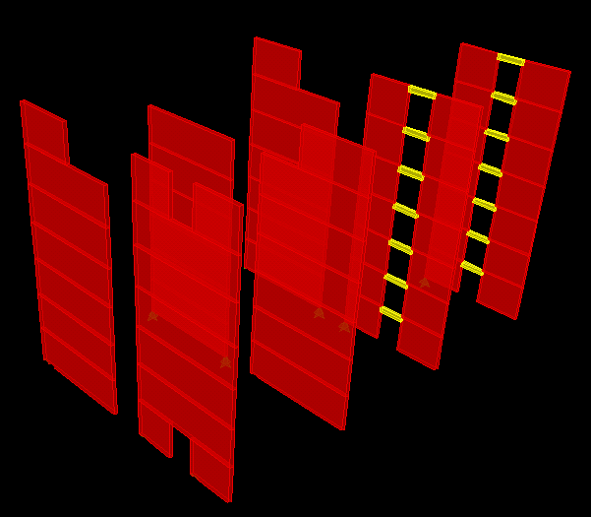




Lateral System Redesign
Presentation Outline
Shear Wall Design Calculations
3D ETABS Model
Introduction
Existing System
Proposal
Gravity System Redesign
  Composite Floor
  Steel Connections
Schedule and Cost Analysis
Lateral System Redesign
Architectural Analysis
Conclusion
Flexural Reinforcement Design
Shear Reinforcement Design
  Capacity Check
  ACI Chapter 11
  Minimum Reinforcements Governed
  Spacing Limitations
Shear walls modeled in ETABS
ETABS used to design shear walls and then checked to design by hand
Controlling Load Case:
  1.54D+1.65E
Tyler Strange
Structural Option
Fraser Centre
Dr. Thomas Boothby
April 13th, 2011

Slide 13
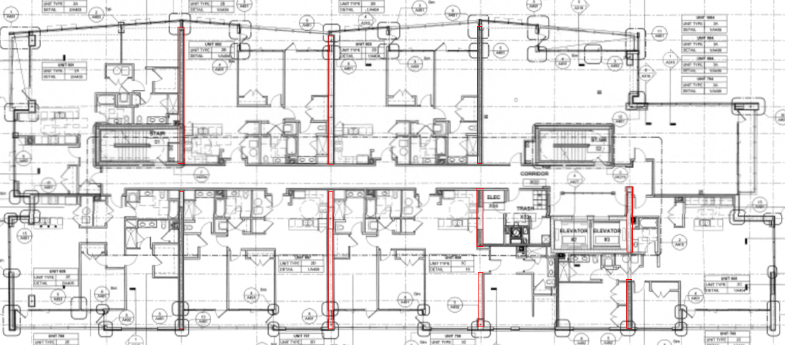
Architectural Analysis
Presentation Outline
5th Floor-10th Floor
Introduction
Existing System
Proposal
Gravity System Redesign
  Composite Floor
  Steel Connections
Schedule and Cost Analysis
Lateral System Redesign
Architectural Analysis
Conclusion
Tyler Strange
Structural Option
Fraser Centre
Dr. Thomas Boothby
April 13th, 2011

Slide 14
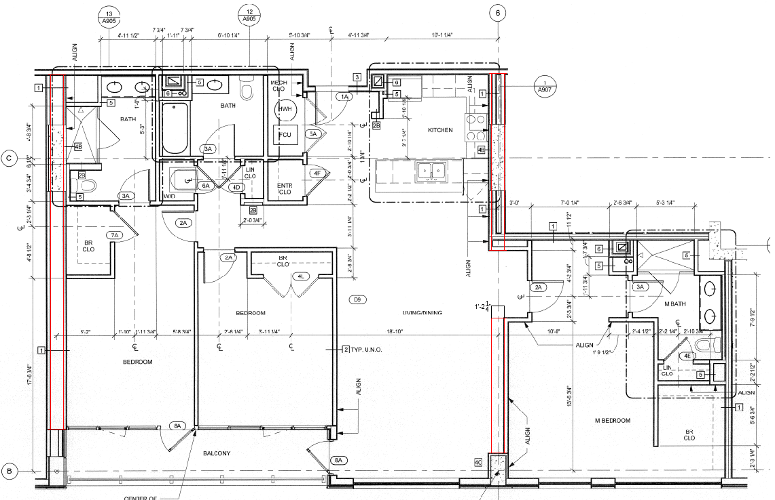
Architectural Analysis
Presentation Outline
5th Floor-10th Floor
Introduction
Existing System
Proposal
Gravity System Redesign
  Composite Floor
  Steel Connections
Schedule and Cost Analysis
Lateral System Redesign
Architectural Analysis
Conclusion
Largest impact on architecture occurs in Unit 3C
Tyler Strange
Structural Option
Fraser Centre
Dr. Thomas Boothby
April 13th, 2011

Slide 15
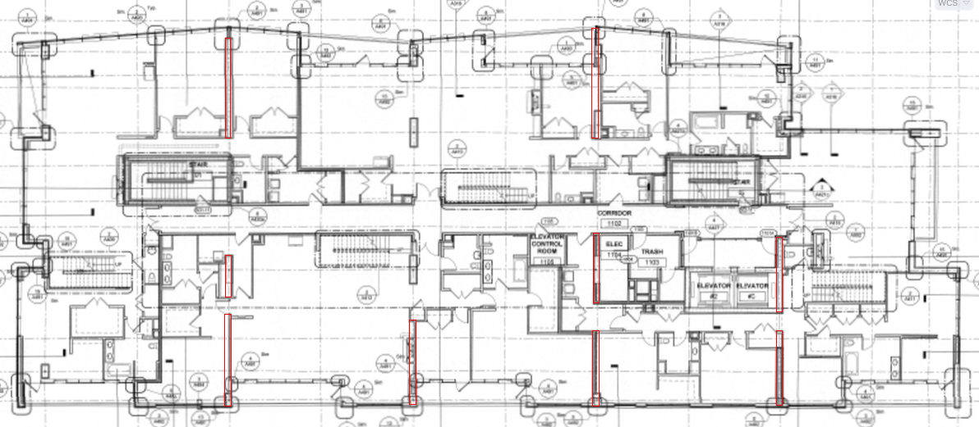
Architectural Analysis
Presentation Outline
11th Floor
Introduction
Existing System
Proposal
Gravity System Redesign
  Composite Floor
  Steel Connections
Schedule and Cost Analysis
Lateral System Redesign
Architectural Analysis
Conclusion
Tyler Strange
Structural Option
Fraser Centre
Dr. Thomas Boothby
April 13th, 2011

Slide 16
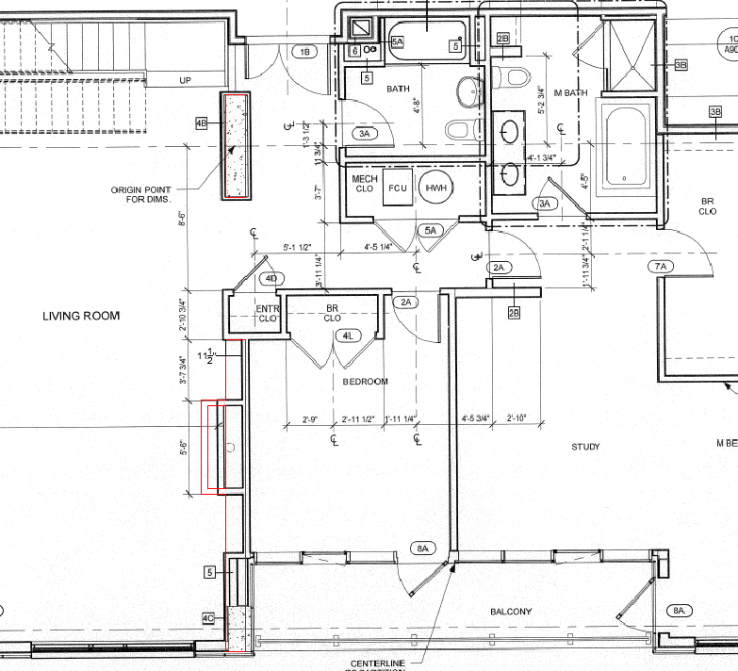
Architectural Analysis
Presentation Outline
11th Floor
Introduction
Existing System
Proposal
Gravity System Redesign
  Composite Floor
  Steel Connections
Schedule and Cost Analysis
Lateral System Redesign
Architectural Analysis
Conclusion
Living room width is reduced by 14”
Tyler Strange
Structural Option
Fraser Centre
Dr. Thomas Boothby
April 13th, 2011

Slide 17
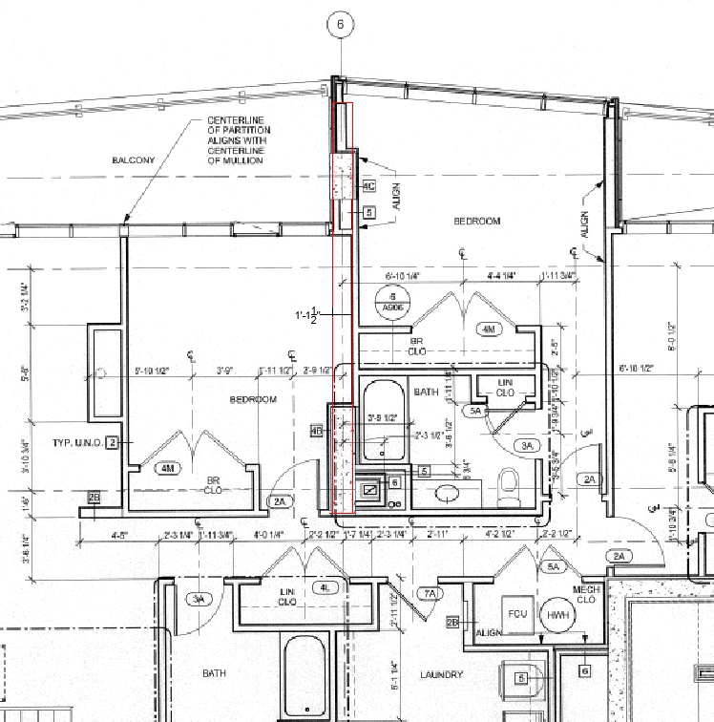
Architectural Analysis
Presentation Outline
11th Floor
Introduction
Existing System
Proposal
Gravity System Redesign
  Composite Floor
  Steel Connections
Schedule and Cost Analysis
Lateral System Redesign
Architectural Analysis
Conclusion
Bedroom width is reduced by 14”
Tyler Strange
Structural Option
Fraser Centre
Dr. Thomas Boothby
April 13th, 2011

Slide 18
Conclusion
Presentation Outline
Introduction
Existing System
Proposal
Gravity System Redesign
  Composite Floor
  Steel Connections
Schedule and Cost Analysis
Lateral System Redesign
Architectural Analysis
Conclusion
Building Weight:
  Existing System: 72,000 kips
  Proposed System: 65,000 kips
  7,000 kip reduction
Architectural Impact:
  Largest impact on floors 5-10 is shortening a single room by roughly 14”.
  Largest impact on the 11th floor is shortening the living room by 14 “.
Cost:
  Existing System: $2.3 million/residential floor
  Proposed System: $7.0 million/residential floor
  Three times more expensive
Schedule:
  Existing System: 24 days/residential floor
  Proposed System: 10 days/residential floor
  Gain 98 work days for all seven residential floors
Tyler Strange
Structural Option
Fraser Centre
Dr. Thomas Boothby
April 13th, 2011

